Slide 1
STUDENT PORTFOLIO
NAME: DEEPEKA.S
REGISTER NO:24131210500122013
DEPARTMENT:2nd BCA
COLLEGE:IMMACULATE COLLEGE FOR WOMEN
NAAN MUDHALVAN ID:asanm121anm12124213013

Slide 2
PORTFOLIO

Slide 3
AGENDA
1.PROBLEM STATEMENT
2.PROJECT OVERVIEW
3.END USERS
4.TOOLS AND TECHNOLOGIES
5.PORTFOLIO DESIGN AND LAYOUT
6.FEATURES AND FUNCTIONALITY
7.RESULTS AND SCREENSHOTS
8.CONCLUSION
9.GITHUB LINK

Slide 4
PROBLEM STATEMENT
Coding a specific task
Debugging an issue
Understanding a concept
Solving a problem

Slide 5
Project overview
Project title:clearly defines the project’s name and purposes.
Objectives:specifies the project’s goals and what it aims to achieve.
Scope:outlines the projects boundaries,including what’s included and excluded.
Target audience: identifies the intended users or beneficiaries of the project.

Slide 6
END USERS
Developer user-centred designs.
Creating relvant features anf functionalities
Providing effective support and services
Building user loyality and satisfaction

Slide 7
TOOLS AND TECHNOLOGIES
Programming languages:Identify the languges used for development.
Databases: choose the databases used for data storage nd management.
Cloud and hosting: decide on te cloud and hosting platforms used for development and deployment.

Slide 8
PORTFOLIO DESIGN AND LAYOUT
Clean and simple: easy to navigate and understand.
Whitespace:use whitespace effectively to create a clean and uncluttered design.
Projects:showcase your work,including images,descriptions, and links.
Regularely update: keep your portfolio up-to-date with fresh content and projects.

Slide 9
FEATURES AND FUNCTIONALITY
Functionality: features provide specific functionality to users.
User experience: feature can enhance or detract from the user experience.
Value peposition: features can contribute to the overall value proposition of a product or service.
Differentiation: features can differentiate a product or service from competitors.

Slide 10
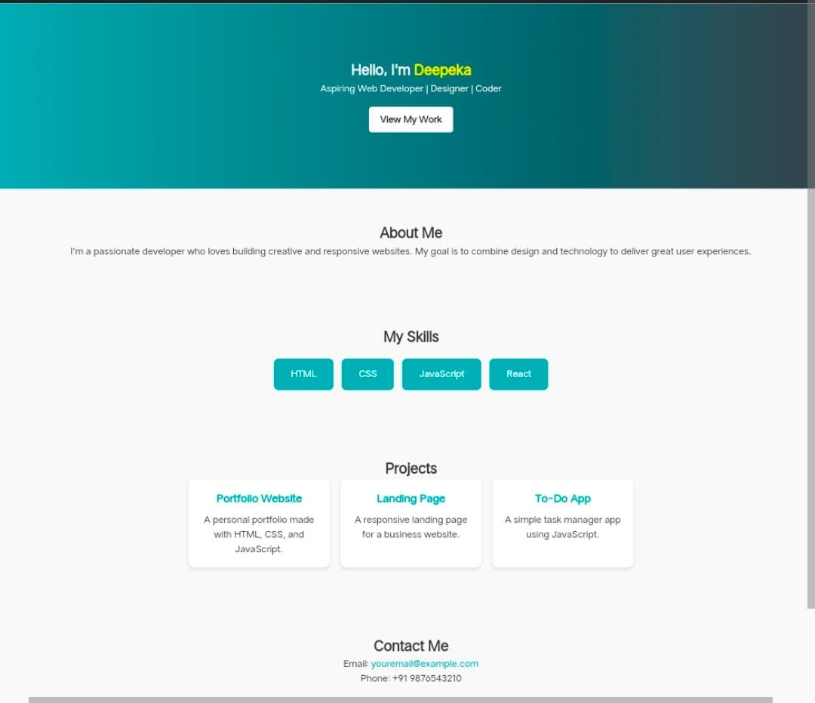
RESULTS AND SCREENSHOTS
Visual proof: screenshots provide visual proof of results,making it easier to understand and verify outcomes.
Demonstrate functionality:screenshots can demonstrate the functionality of a product or feature.

Slide 11
conclusion
Project addressed the problem statement.
Utilized suitable tool and technologies.
Designed with end users in mind.
Results and functionality are showcased.
Code available on github for reference.

Slide 12
GITHUB LINK
Direct github repository link.
https://github.com/deepekasambath-byte/DEEPEKA_TNSD_FWD_DP.git

